Slide 1
WELCOME TO Marble Falls HIGH SCHOOL

Slide 2
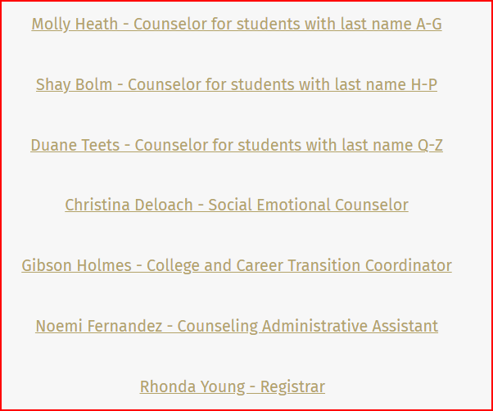
Meet our Counseling staff!

Slide 3
Counseling website:
https://www.marblefallsisd.org/domain/245
Our website has lots of information:
Scheduling , needed forms, Dual Credit info, presentations, scholarship info, senior information, summer information, testing, suicide or self-harm/community resources, club and organizations, etc.

Slide 4
Grades Matter
Attendance Matters

Slide 5
Grades/Attendance
You must make a 70 or higher to pass a course
You must not miss more than 10 days per semester in order to receive credit
Semester grades within the same school year can long average
English 1 Fall = 65 English 1 Spring = 75 English 1 – 70 for 1 credit
English 1 Fall = 65 English 1 Spring = 72 English 1 – 68 must repeat course

Slide 6
Grade Classification in High School
0 – 5.5 credits = 9th grade
6 – 12.5 credits = 10th grade
13 – 19.5 credits = 11th grade
20+ credits = 12th grade

Slide 7
What is GPA?
Grade Point Average - #1 thing colleges look at!
Included in GPA are core classes, foreign language and any “Honors, Dual Credit (available to all students), On-Ramps or AP course taken on campus. Summer school or correspondence courses do not count.
Core classes are English, Math, Science, and Social Studies
GPA starts with the first high school credit course taken on our campus (middle school grades do not count in GPA)!

Slide 8
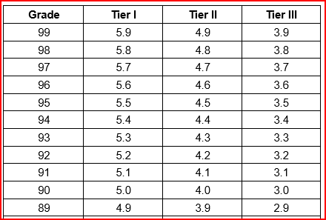
On-Level/DC/Honors/AP/On-Ramps
Tier I—Eligible AP courses and OnRamps courses
Tier II—Eligible dual credit courses and courses locally designated as honors
Tier III—All other eligible courses

Slide 9
What is Class Rank?
Based on your weighted GPA
Only includes the courses that count in GPA
Top 10% can get automatic admission to Texas public colleges (see automatic admissions chart). You can apply to colleges at the end of your Junior year, so you have 6 semesters to impress colleges!
Your rank is determined by your GPA and the total number of students in your class:
Divide your class rank by the total number of students in your class to get your percentile rank. Hint – your class size will likely get smaller each year.

Slide 10
GPA and Rank
GPA and rank are sent to apply for colleges at the end of the Junior year.
Rank at the end of the Junior year or Senior year can be used to determine admission to colleges/universities including automatic admission for Texas colleges/universities

Slide 11
Automatic Admission Requirements for Texas Public Universities (could change)
UT Austin
-Must be in top 6% of graduating class
Sul Ross State University
-Students in the top 50% receive assured admission
Texas A&M
-Top 10%: No test score requirements.
-Top 25%: Individual review
UT Permian Basin
-Must be in top 25% of graduating class.
26-50% - SAT 1020 or ACT 20
Texas Tech
-Top 10%: No test score requirements.
-Top 25%: SAT 1180; ACT 24
Angelo State University
-Top 25%: No test score requirements.
-Top 50%: SAT 920; ACT 17
Texas State University
-Top 10%: No test score requirements.
-Top 25%: SAT 1000; ACT 20

Slide 12
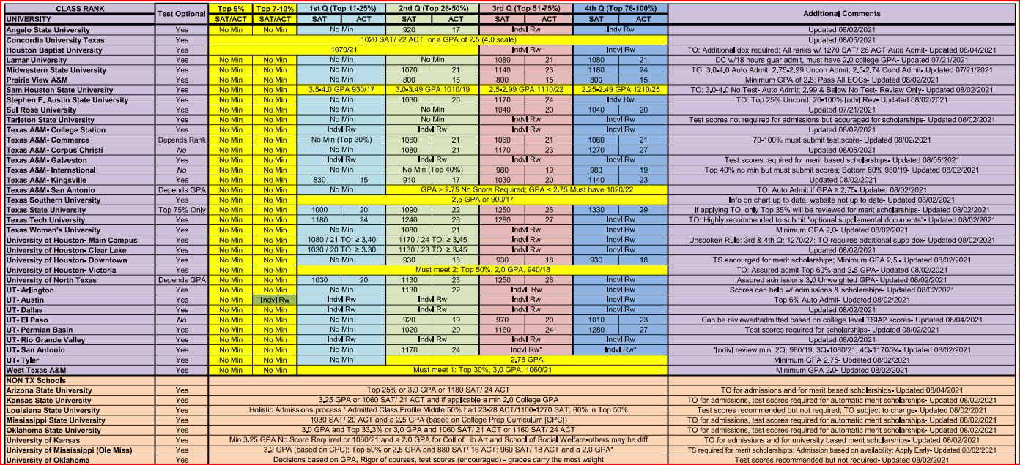
Assured Admission (Guaranteed to get in)!

Slide 13
The Distinguished Level of Achievement
The Distinguished Level of Achievement will:
Allows students to be considered for Top 10% automatic admissions eligibility at any Texas public university with the exception of The University of Texas at Austin; Automatic admission standards for UT are established during the student’s junior year
What it means
The Distinguished Level of Achievement requires more math and more science than the Foundation High School Program.
The Distinguished Level of Achievement requires:
A total of four credits in math, including Algebra II;
A total of four credits in science; and
Successful completion of an endorsement in your area of interest.

Slide 14
Subject Area | Number of Required Credits
English | 4: English 1, II, III, IV
Math | 4: Algebra 1 & Geometry plus 2 additional math credits
Science | 4: Biology, IPC, Chem or Physics plus 2 additional science credits
Social Studies | 3 (4 recommended) World Geo or WH, USH and Gov/Eco
LOTE | 2 levels in same foreign language
PE | 1 credit in PE or PE equivalent
Fine Arts | 1: Art, Dance, Band, Choir, Theater, Floral Design
Electives | 9 28 Total Credits Required for Graduation

Slide 15
What are the five endorsement areas (need one to graduate on the recommended or higher grad plan)?
1. STEM
2. Public Services
3. Business and Industry
4. Arts and Humanities
5. Multidisciplinary Studies

Slide 19
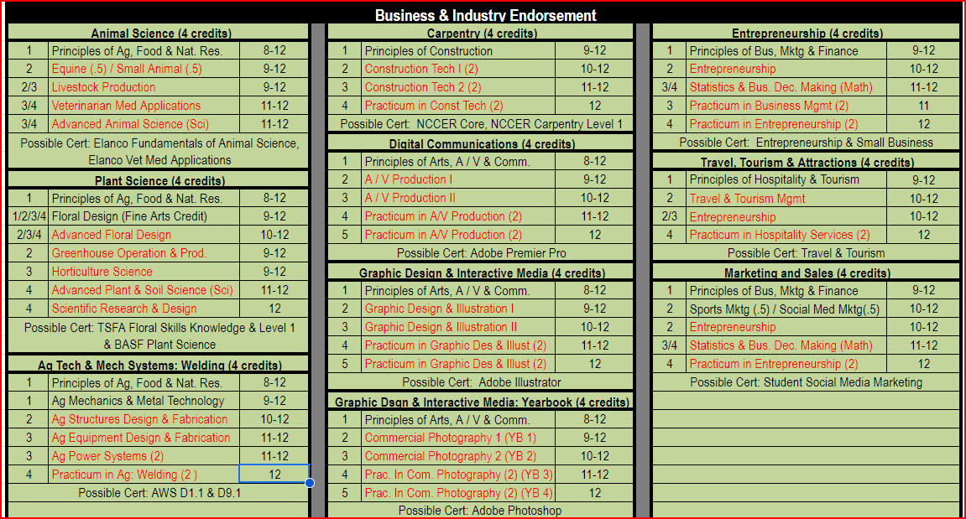

Slide 20
End of Course Exams (STAAR Tests)
English 1 (9th)
Algebra 1 (9th) – 8th graders in Algebra 1 will take this in middle school
Biology (9th)
English II (10th)
US History (11th)

Slide 21
Questions?

